Slide 1

Dynamics is a missing link for understanding microbiota-dependent heterogeneity in prebiotic responses
Chen Liao, Ph.D., Joao Xavier Lab
Program for Computational and Systems Biology
Memorial Sloan Kettering Cancer Center, New York
In collaboration with Dai Lab, Shenzhen

Slide 2

Replicability issue in microbiome science
Reproducibility: ability to regenerate a result with same dataset and analysis
Replicability: ability to produce a consistent result with an independent experiment asking the same scientific question
Clinical trials: Does resistant starch promotes SCFA?
Baxter et al. mBio, (2019): promote butyrate production in only 63% adults
Venkataraman et al., Microbiome (2016): three patterns of butyrate change—enhanced, high and low
Solutions: we need dynamics and microbiota-based stratification
Dynamics: (1) same endpoint values but different trends; (2) evolution of variability from start to end
Microbiome-based stratification: stratification of subjects based on microbiome features, instead of demographic parameters (age, sex, …)

Slide 3
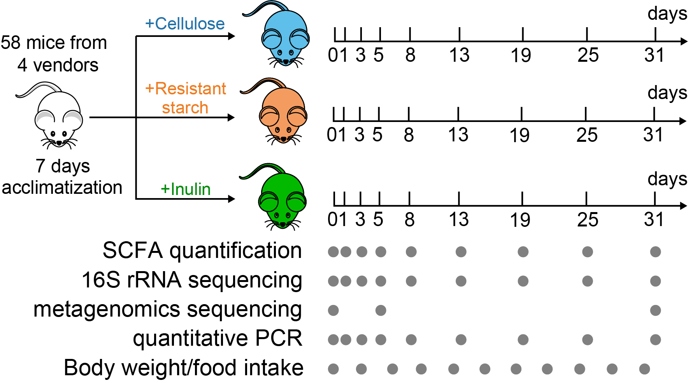
Experimental design: mimicking human microbiota stratification

Slide 4
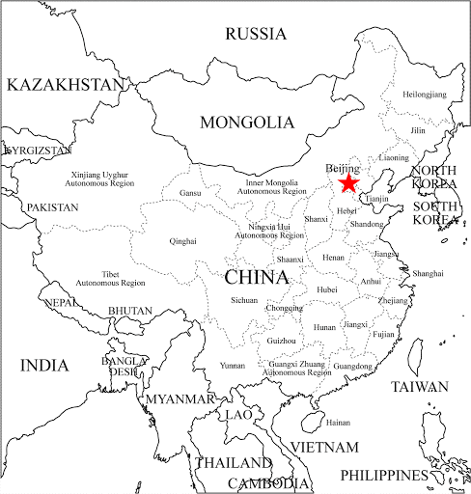
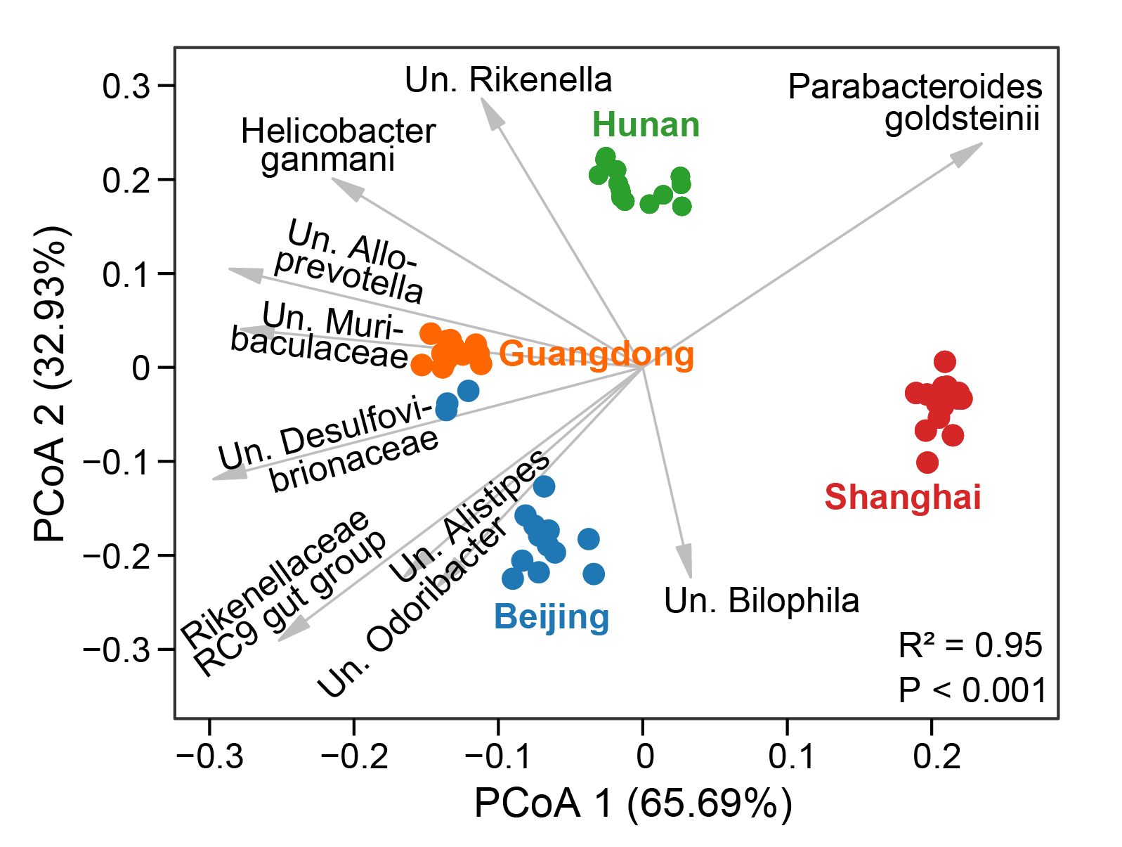
Baseline microbiota characteristics
Beijing
Shanghai
Hunan
Guangdong

Slide 5
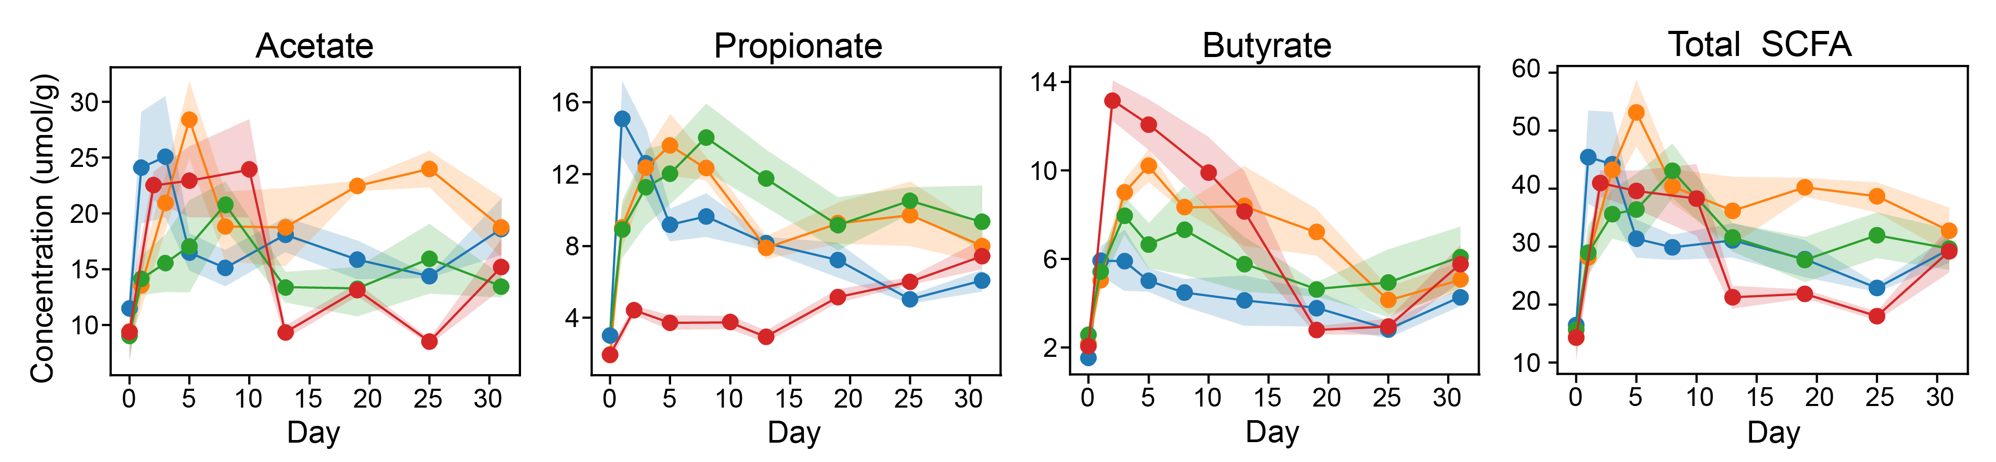
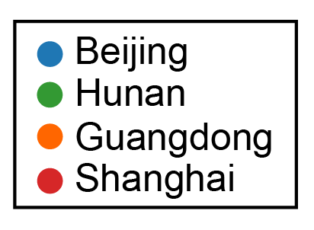
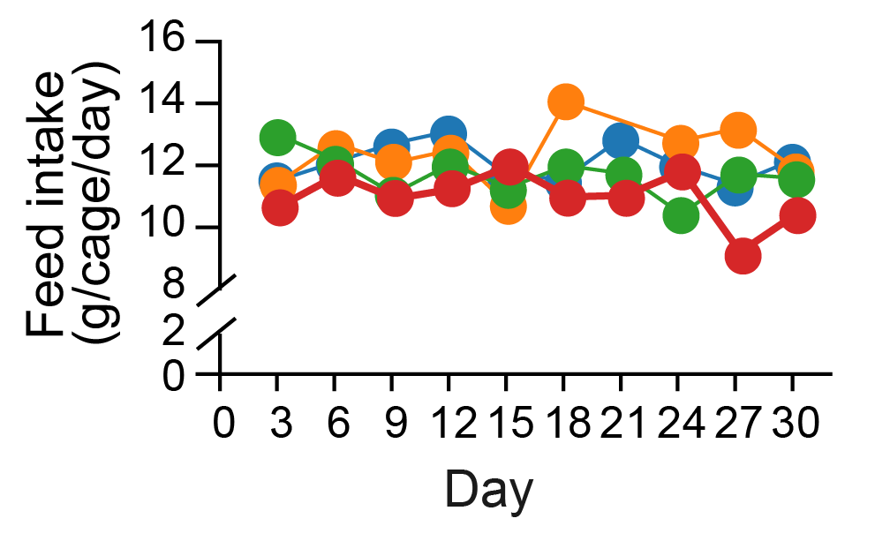
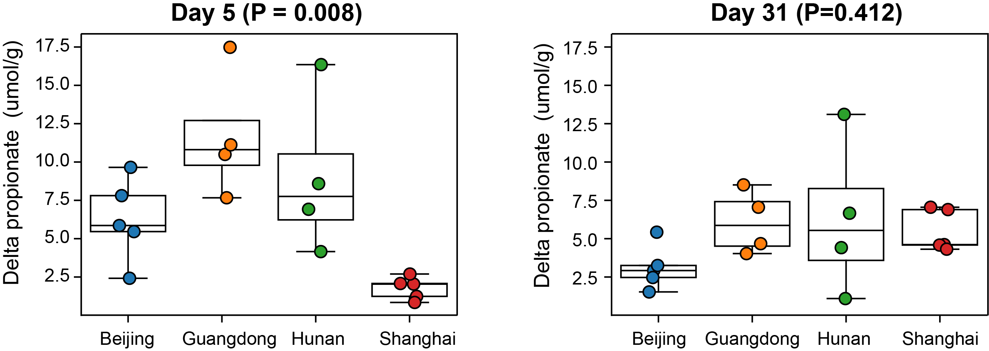
Biphasic dynamics of SCFAs
Statistical test using pre-to-post change in Propionate
Feed intake rate

Slide 6
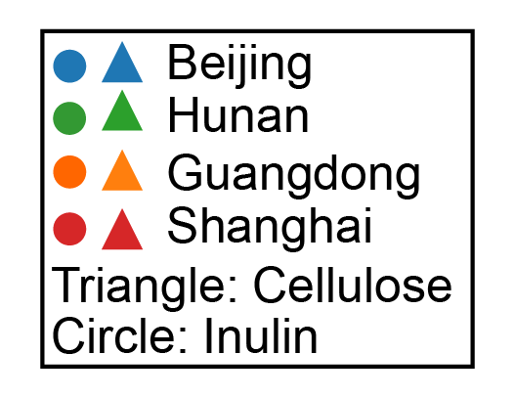
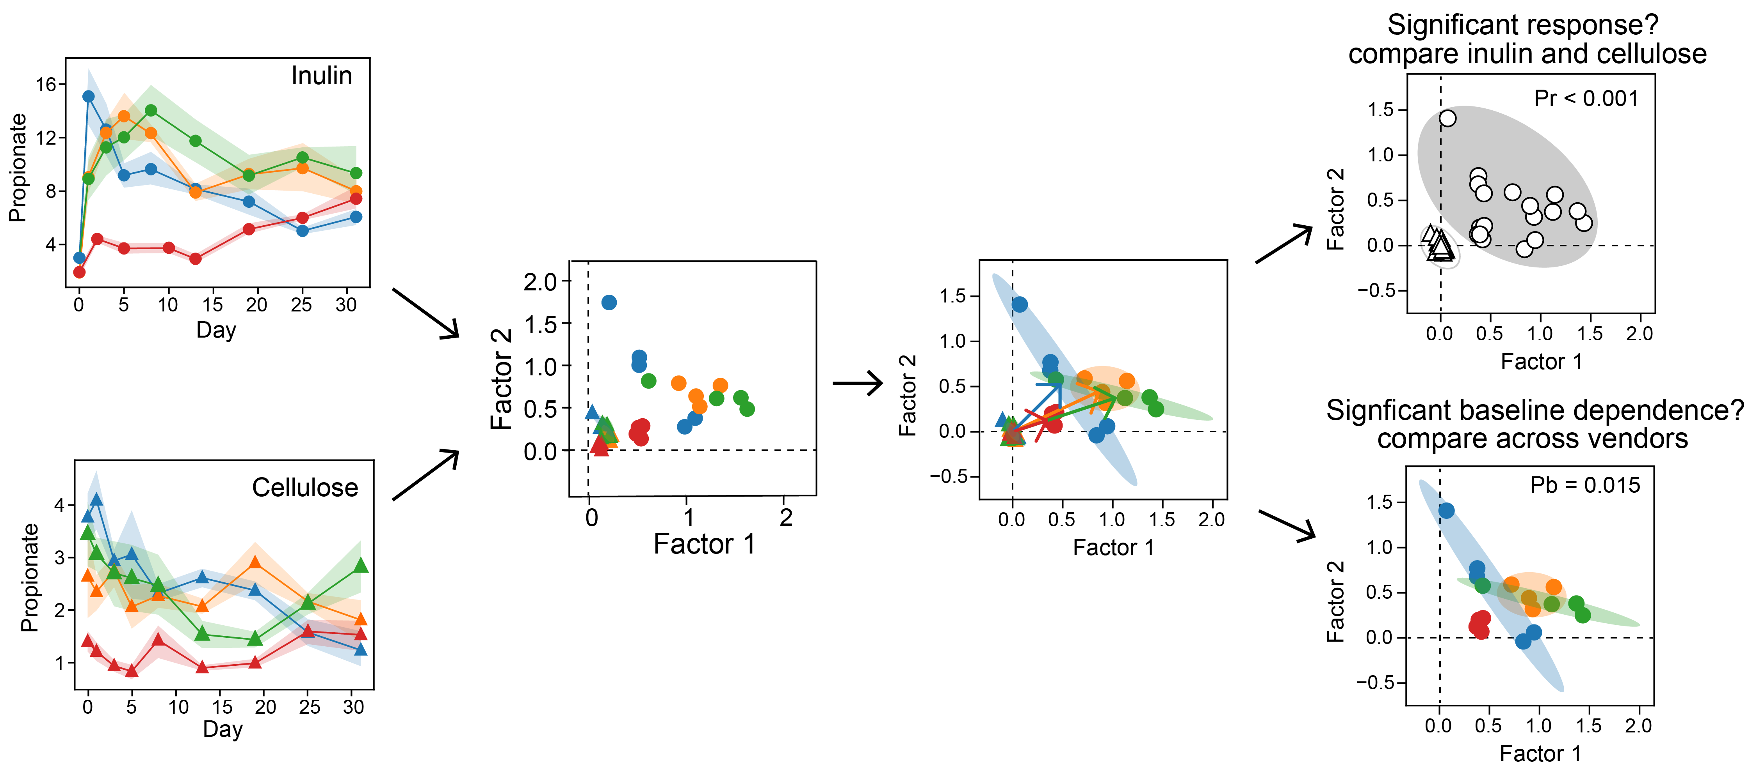
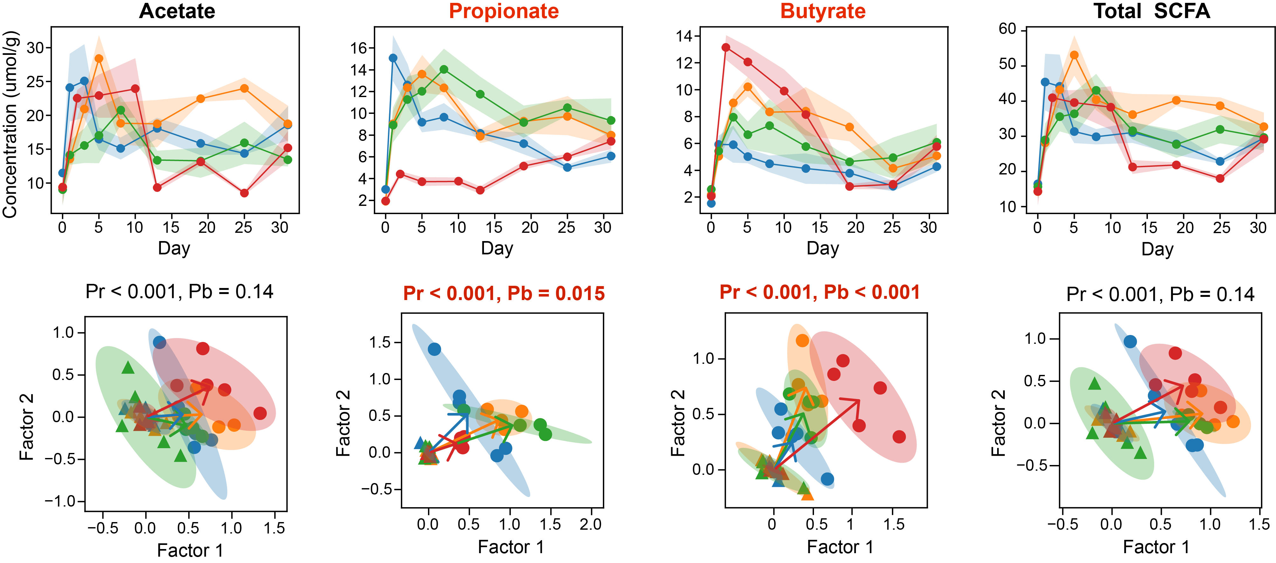
Quantification of baseline-dependent response
Baseline-dependent response = “baseline-dependent” + “response”

Slide 7
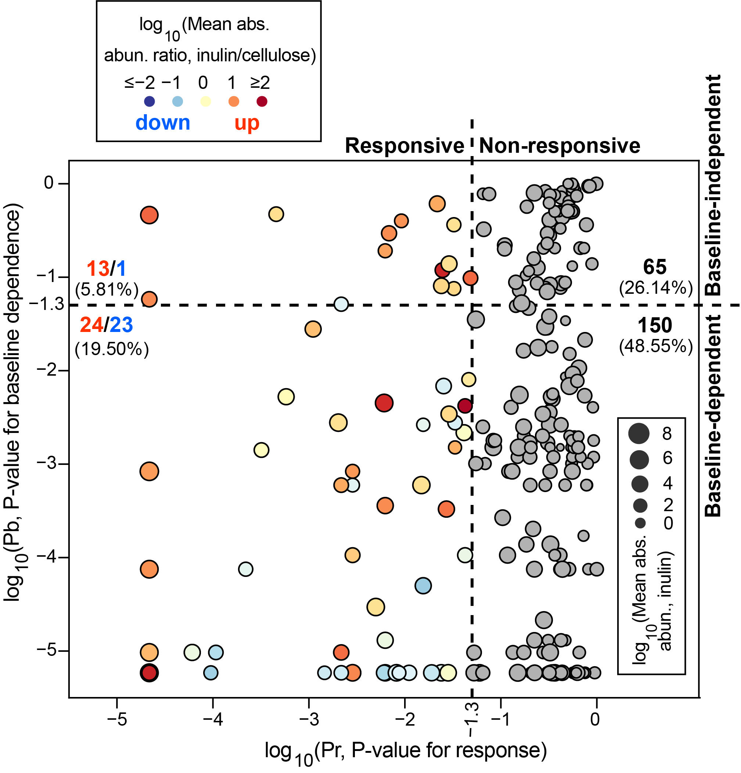
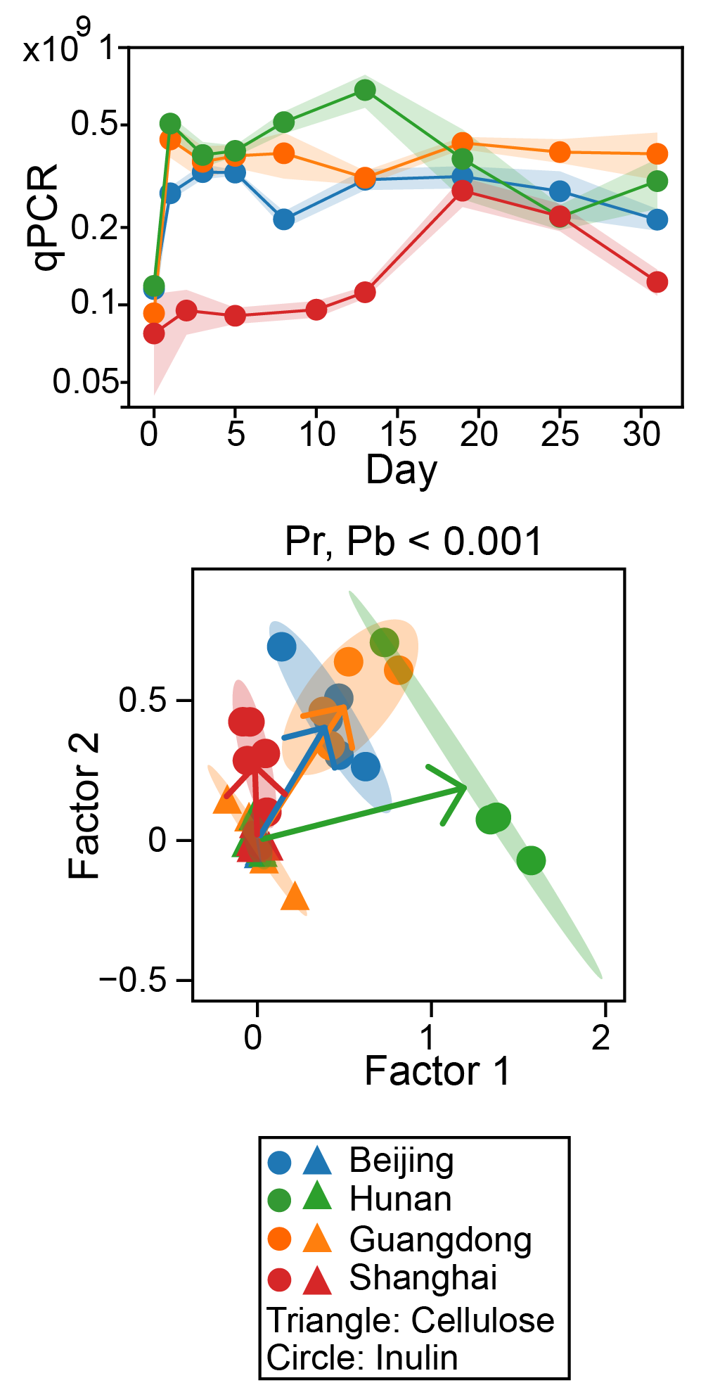
~20% species shows heterogenous responses

Slide 8
Which species are inulin responders (primary degraders)?
Bacterial species | Fold change (inulin/cellulose) | Pr (responsiveness) | Pb (baseline dependence)
Un. NK4A214 group | 1.02E+00 | 3.20E-04 | 1.41E-03
Un. Desulfovibrio | 1.10E+00 | 5.79E-04 | 5.26E-03
[Clostridium] leptum | 1.85E+00 | 4.63E-02 | 8.03E-03
Un. Bacteroides | 2.30E+00 | 4.97E-03 | 2.96E-05
Un. Alloprevotella | 2.41E+00 | 2.03E-03 | 2.78E-03
Un. Lachnospiraceae NK4A136 group | 2.45E+00 | 1.49E-02 | 5.96E-04
Mouse-gut-metagenome | 2.75E+00 | 2.88E-02 | 3.44E-03
Alistipes shahii | 3.64E+00 | 2.85E-03 | 1.06E-04
Bacteroides acidifaciens | 3.65E+00 | 2.17E-05 | 8.37E-04
Bacteroides caecimuris | 4.67E+00 | 1.11E-03 | 2.79E-02
Un. Faecalibaculum | 5.18E+00 | 2.17E-05 | 9.65E-06
Christensenella sp. Marseille-P2437 | 5.85E+00 | 3.33E-02 | 1.51E-03
Un. Prevotellaceae UCG-001 | 6.68E+00 | 2.17E-03 | 5.96E-04
Un. Muribaculaceae | 7.97E+00 | 2.17E-05 | 8.37E-04
Un. Bacteria | 8.58E+00 | 2.85E-03 | 8.37E-04
Un. Parasutterella | 9.54E+00 | 2.17E-05 | 7.51E-05
Un. Gastranaerophilales | 1.04E+01 | 6.24E-03 | 3.60E-04
Un. Muribaculum | 1.09E+01 | 2.85E-03 | 5.85E-06
Akkermansia muciniphila | 1.46E+01 | 2.17E-05 | 5.85E-06
Bifidobacterium choerinum | 1.48E+01 | 2.71E-02 | 3.30E-04
Un. Tannerellaceae | 1.58E+01 | 2.17E-03 | 9.65E-06
Bacteroides uniformis | 4.46E+01 | 6.08E-03 | 4.51E-03
Un. Coriobacteriaceae UCG-002 | 5.16E+01 | 2.17E-05 | 5.85E-06
Un. Frisingicoccus | 8.82E+01 | 4.24E-02 | 4.20E-03
Bacterial species | Fold change (inulin/cellulose) | Pr (responsiveness) | Pb (baseline dependence)
Un. NK4A214 group | 1.02E+00 | 3.20E-04 | 1.41E-03
Un. Desulfovibrio | 1.10E+00 | 5.79E-04 | 5.26E-03
[Clostridium] leptum | 1.85E+00 | 4.63E-02 | 8.03E-03
Un. Bacteroides | 2.30E+00 | 4.97E-03 | 2.96E-05
Un. Alloprevotella | 2.41E+00 | 2.03E-03 | 2.78E-03
Un. Lachnospiraceae NK4A136 group | 2.45E+00 | 1.49E-02 | 5.96E-04
Mouse-gut-metagenome | 2.75E+00 | 2.88E-02 | 3.44E-03
Alistipes shahii | 3.64E+00 | 2.85E-03 | 1.06E-04
Bacteroides acidifaciens | 3.65E+00 | 2.17E-05 | 8.37E-04
Bacteroides caecimuris | 4.67E+00 | 1.11E-03 | 2.79E-02
Un. Faecalibaculum | 5.18E+00 | 2.17E-05 | 9.65E-06
Christensenella sp. Marseille-P2437 | 5.85E+00 | 3.33E-02 | 1.51E-03
Un. Prevotellaceae UCG-001 | 6.68E+00 | 2.17E-03 | 5.96E-04
Un. Muribaculaceae | 7.97E+00 | 2.17E-05 | 8.37E-04
Un. Bacteria | 8.58E+00 | 2.85E-03 | 8.37E-04
Un. Parasutterella | 9.54E+00 | 2.17E-05 | 7.51E-05
Un. Gastranaerophilales | 1.04E+01 | 6.24E-03 | 3.60E-04
Un. Muribaculum | 1.09E+01 | 2.85E-03 | 5.85E-06
Akkermansia muciniphila | 1.46E+01 | 2.17E-05 | 5.85E-06
Bifidobacterium choerinum | 1.48E+01 | 2.71E-02 | 3.30E-04
Un. Tannerellaceae | 1.58E+01 | 2.17E-03 | 9.65E-06
Bacteroides uniformis | 4.46E+01 | 6.08E-03 | 4.51E-03
Un. Coriobacteriaceae UCG-002 | 5.16E+01 | 2.17E-05 | 5.85E-06
Un. Frisingicoccus | 8.82E+01 | 4.24E-02 | 4.20E-03

Slide 9
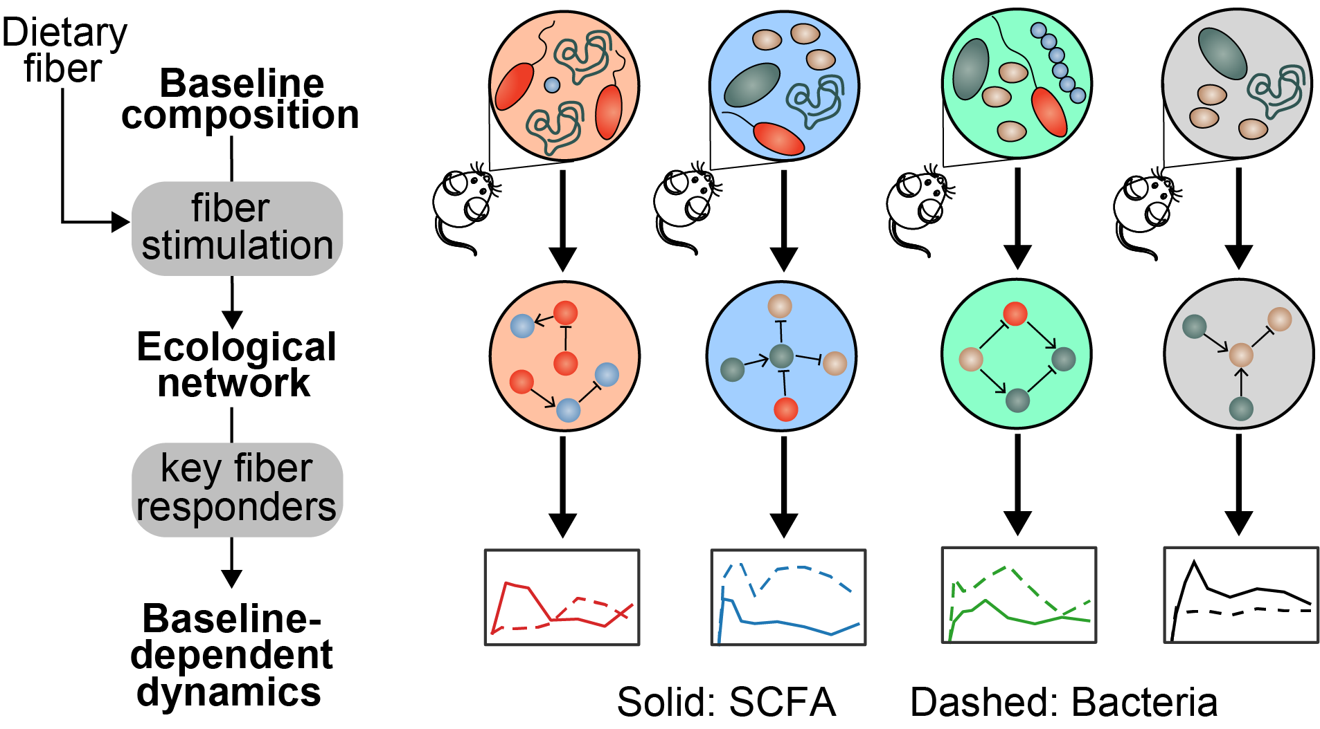
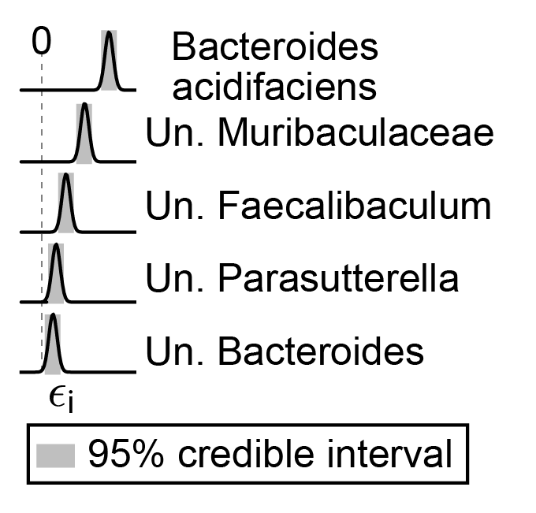
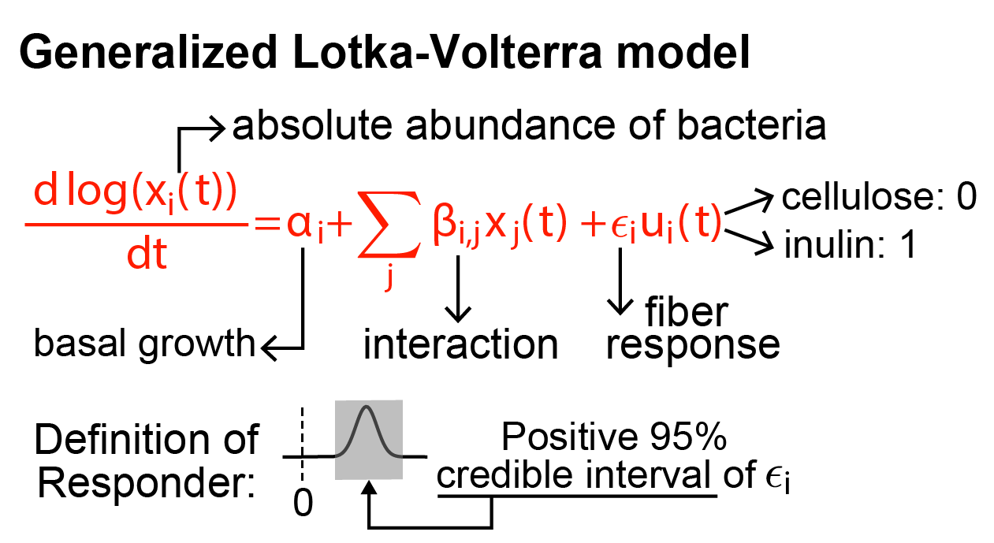
Ecology transforms variability from start to end
Confirmed by reanalyzing data from Chijiiwa et al., Microbiome (2020)
Notes:
Hunan: others mainly include akkermansia muciniphila and Bacteroides uniformis

Slide 10
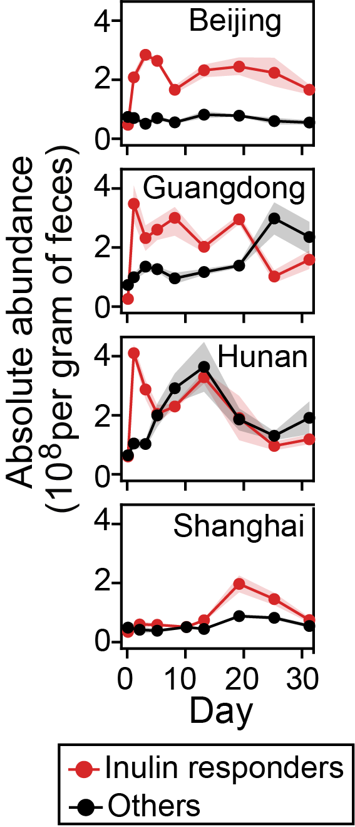
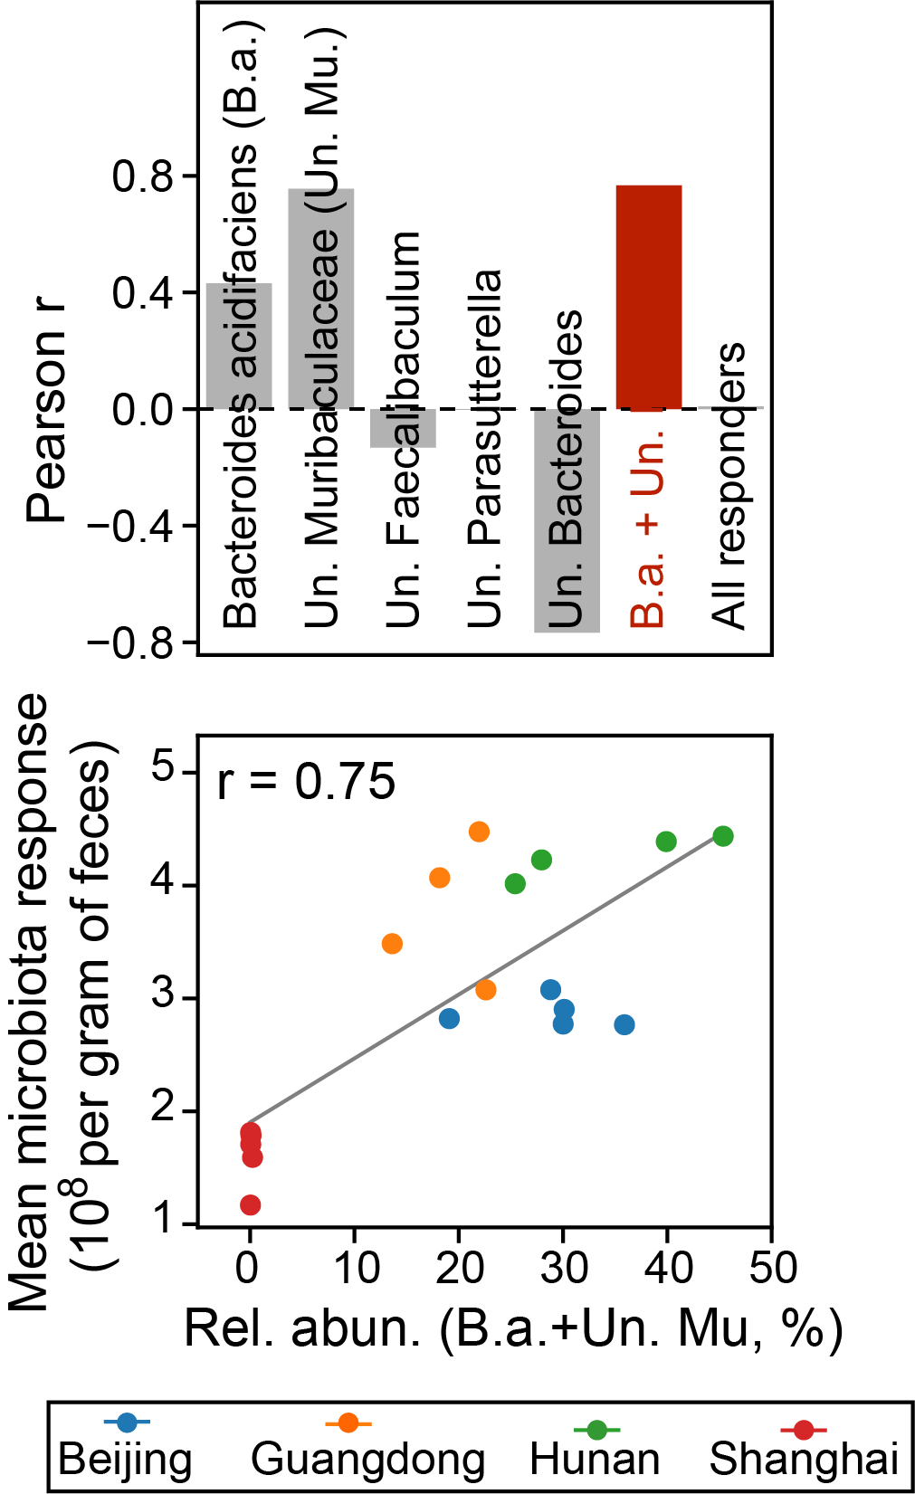
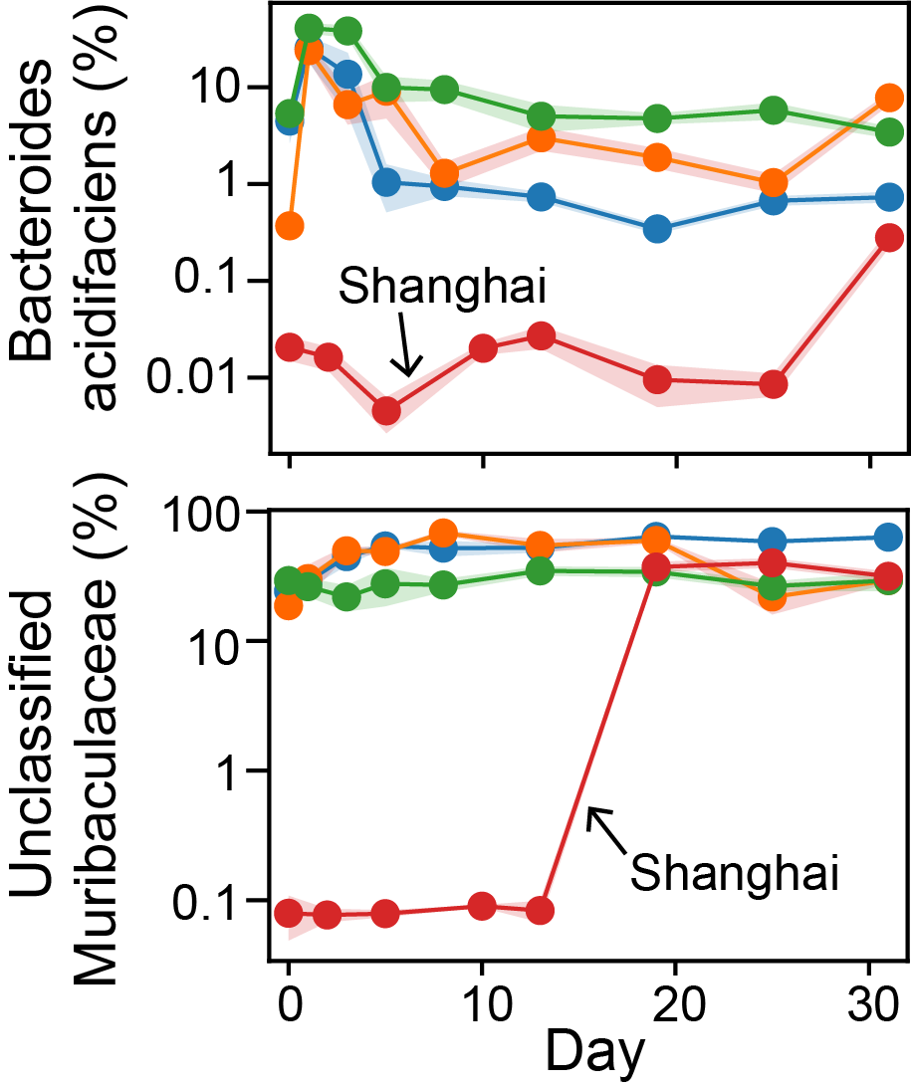
A few inulin responders dominate microbiota responses
Use responders (relative abundance) to predict mean microbiota response (absolute abundance)
Notes:
Hunan: others mainly include akkermansia muciniphila and Bacteroides uniformis

Slide 11
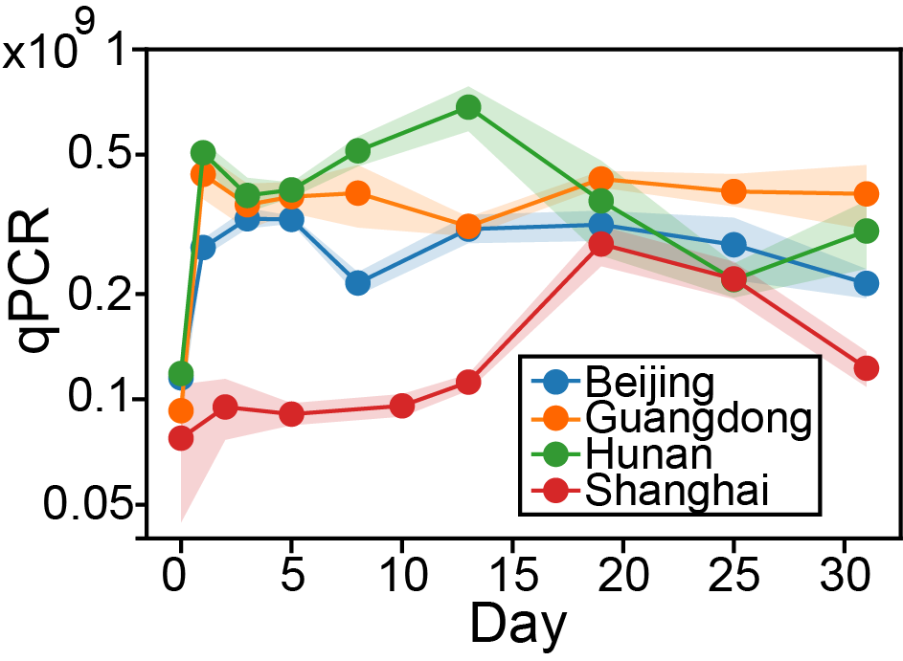
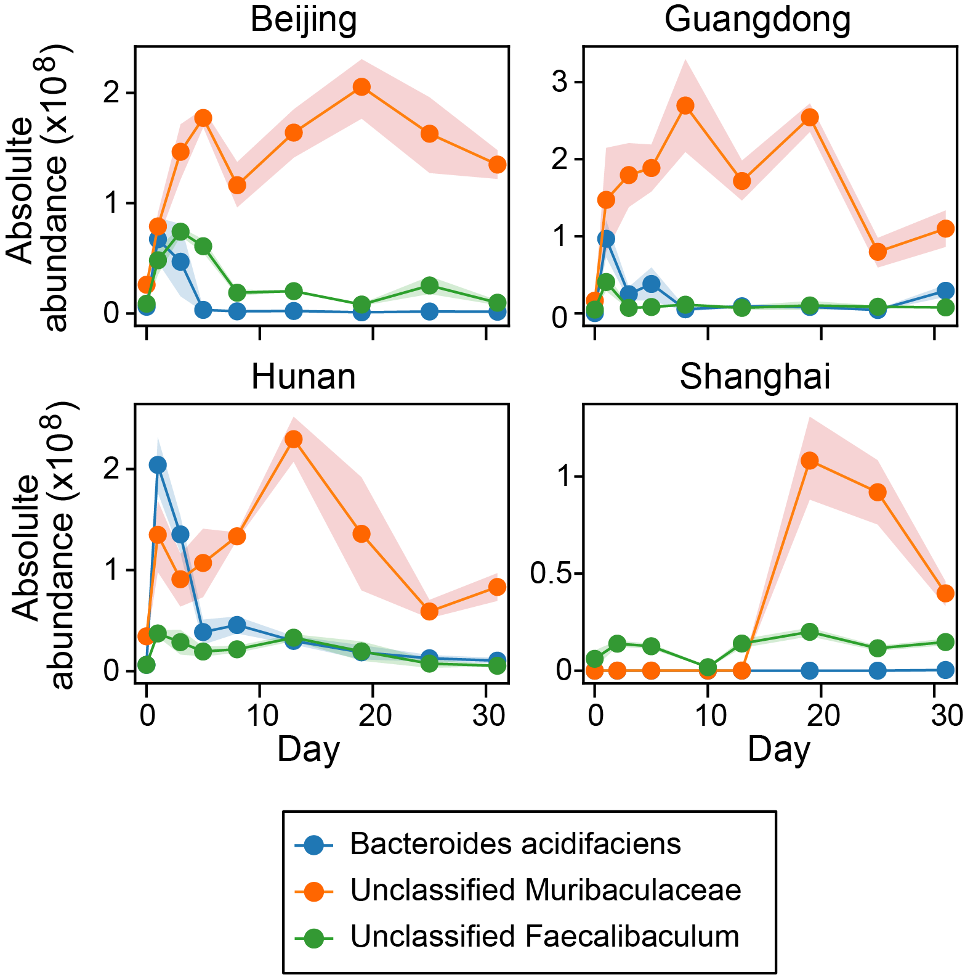
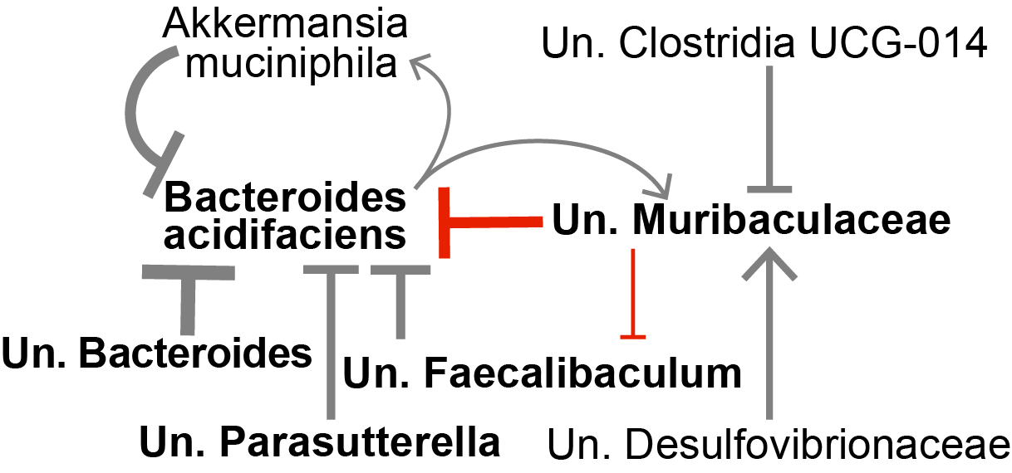
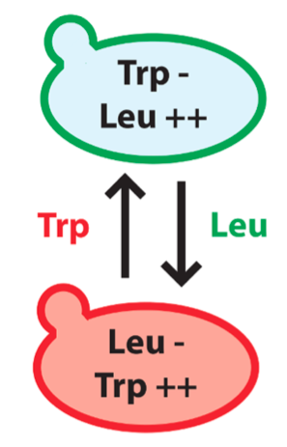
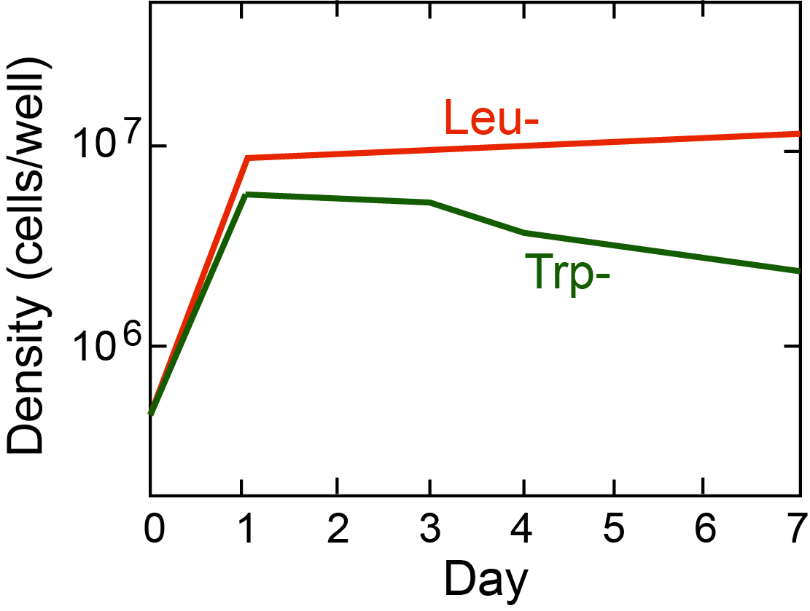
“Activation-then-competition” mechanism for responder dynamics
supply high Leu and Trp
Hoek, Tim A., et al. PLoS biology 14.8 (2016): e1002540.

Slide 12
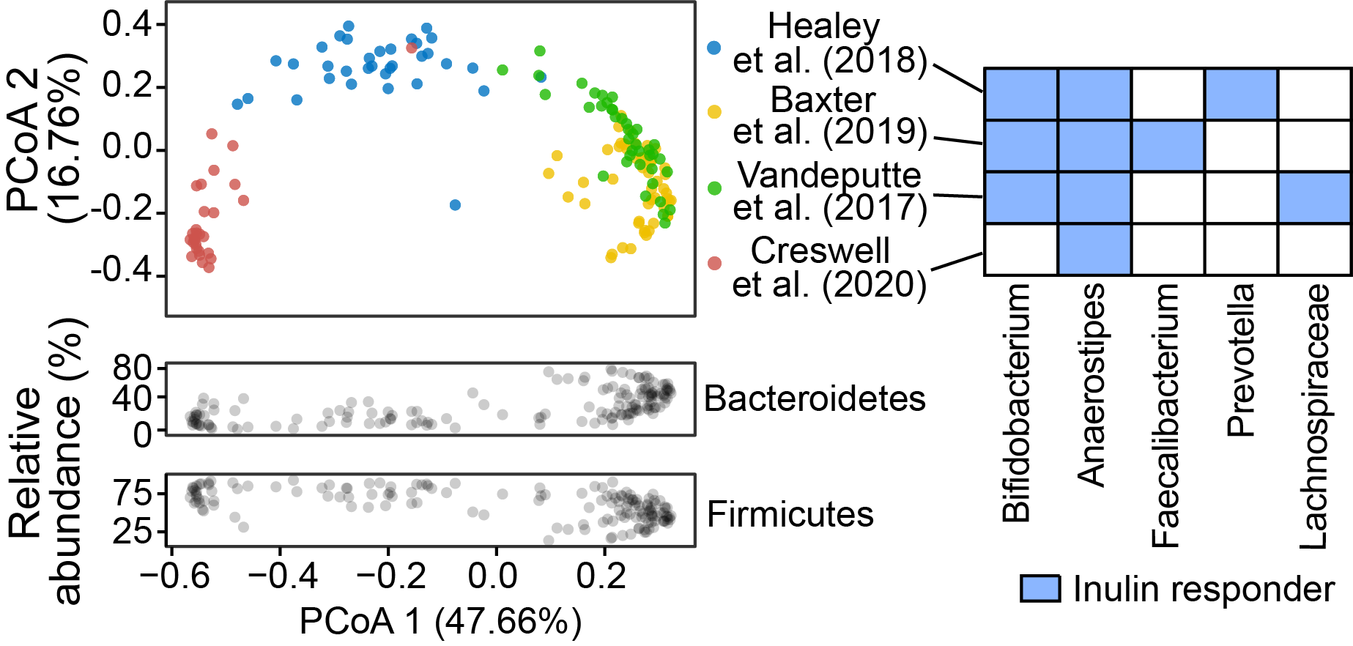
Robust inference of inulin responders in human datasets

Slide 13
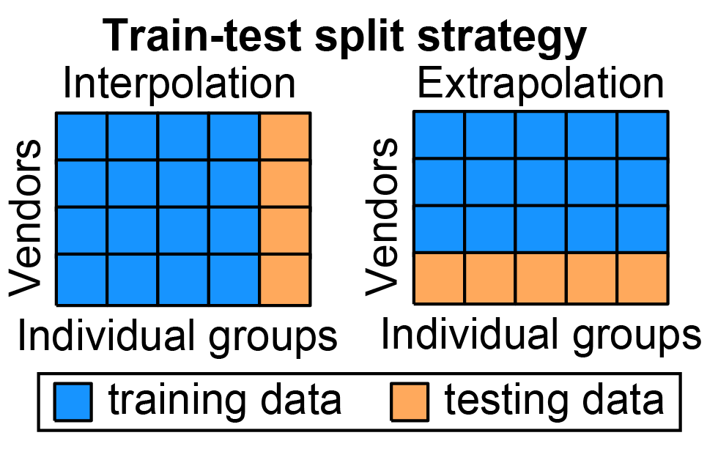
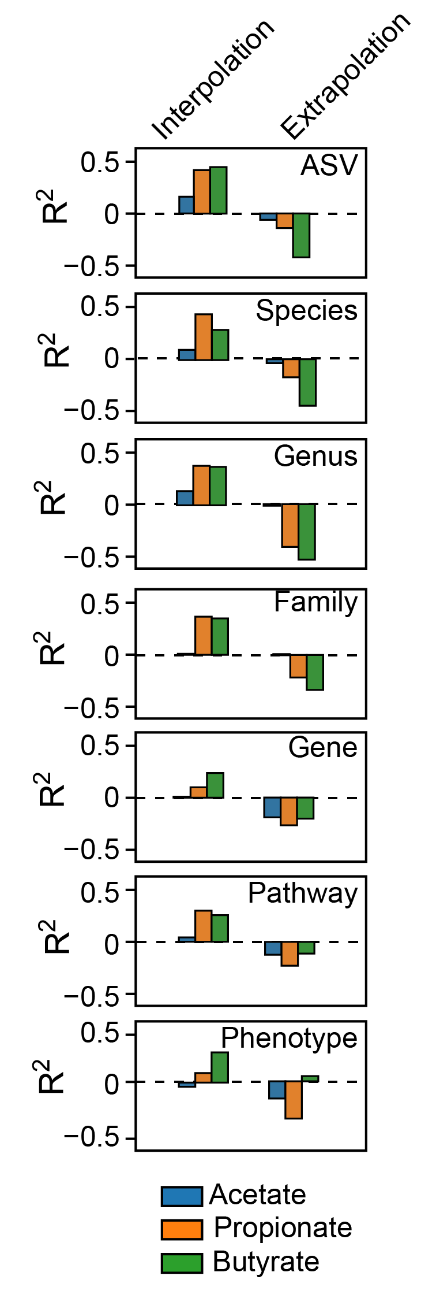
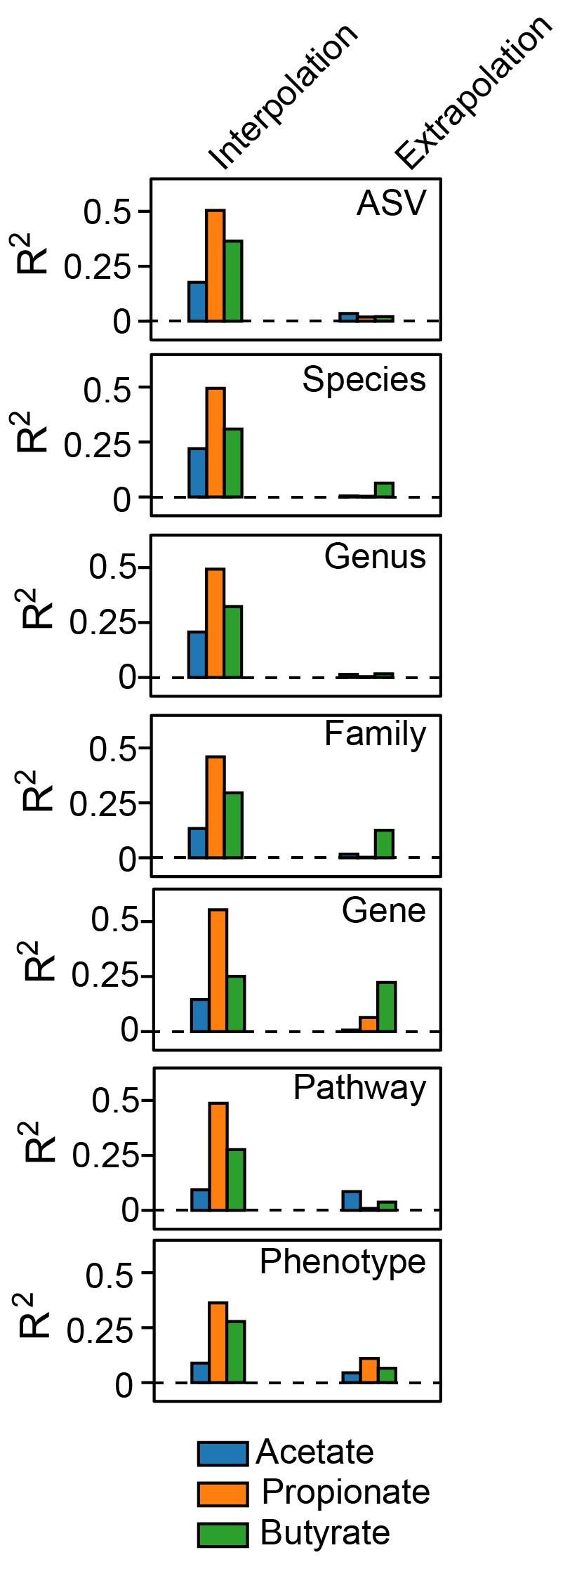

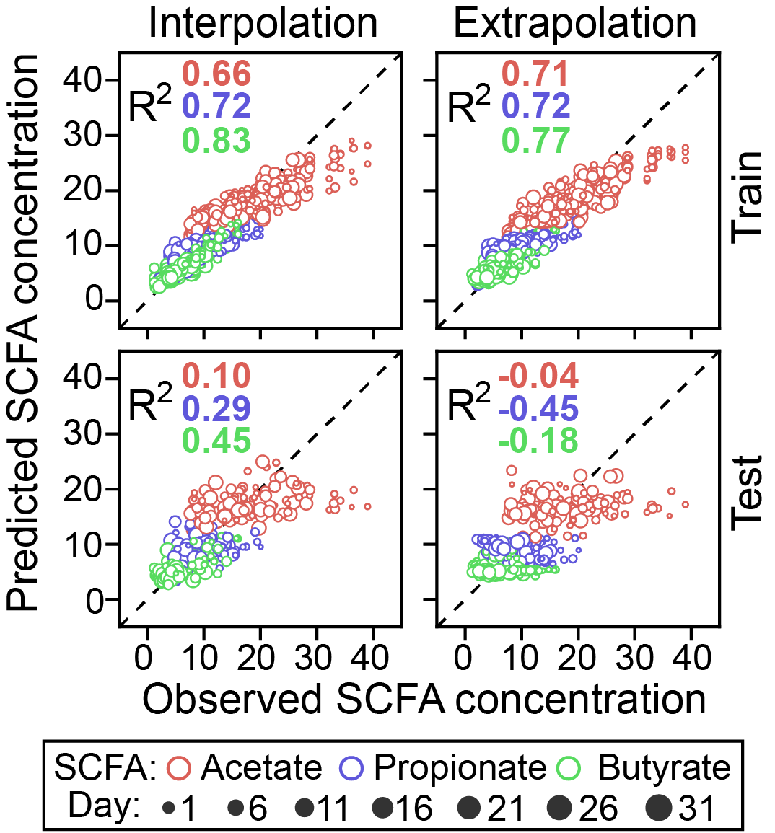
Can we predict SCFAs from microbiota? It depends!
Random Forest regression
MelonnPan (penalized regression)
SCFA~Random Forest (Absolute abundance of bacterial species)
Mallick, Himel, et al. Nat. Commun. 10.1 (2019): 1-11.

Slide 14
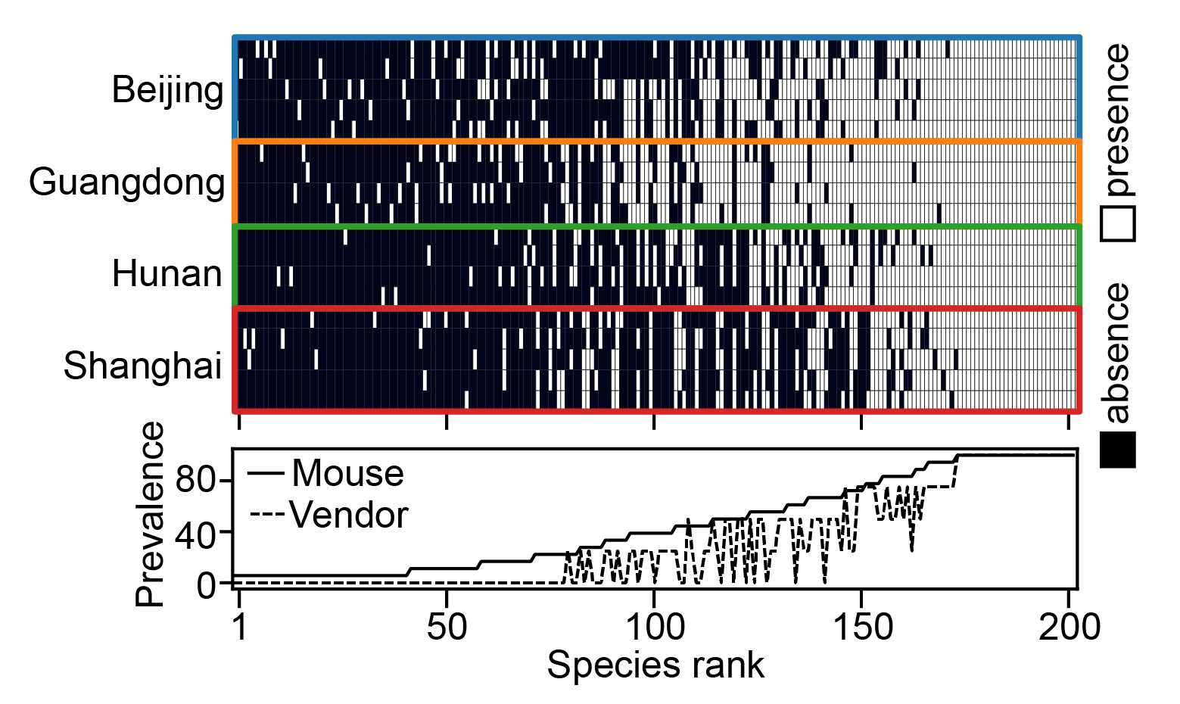
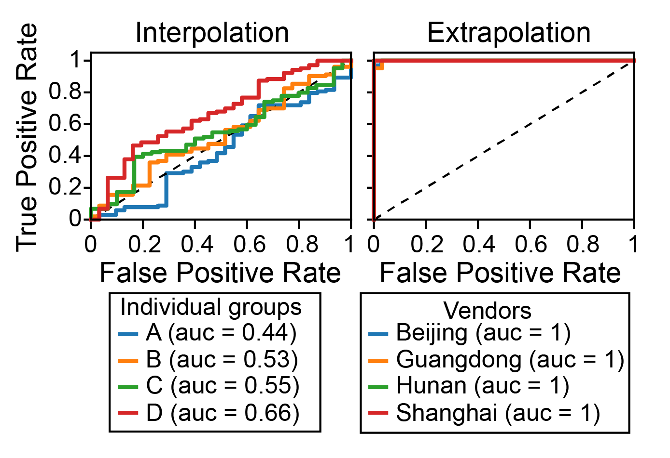
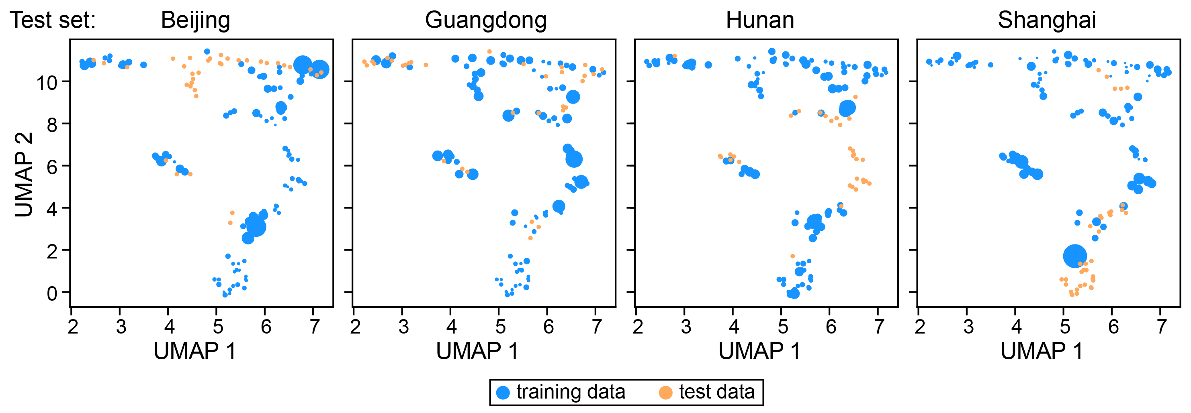
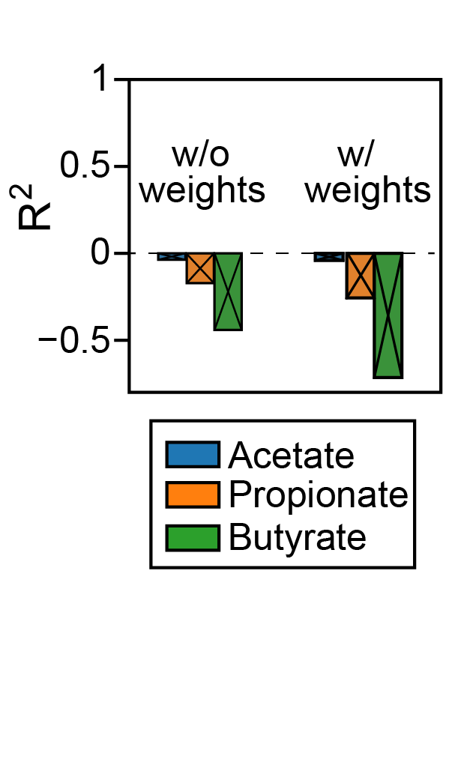
Covariate shift in machine learning

Slide 15
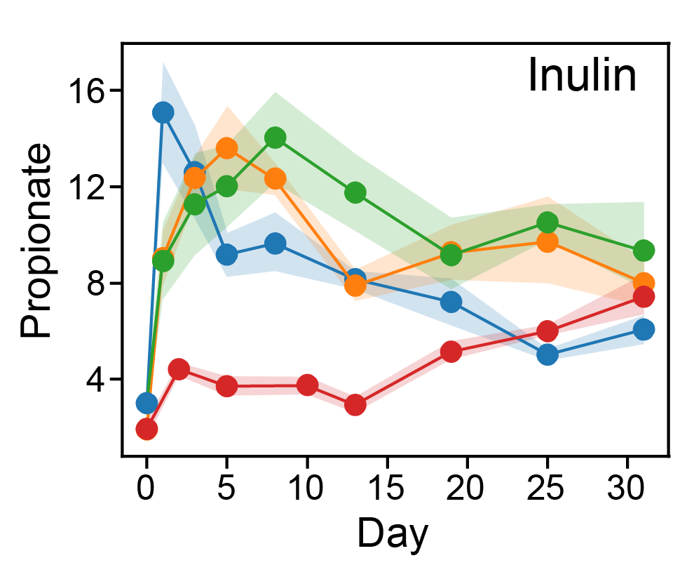
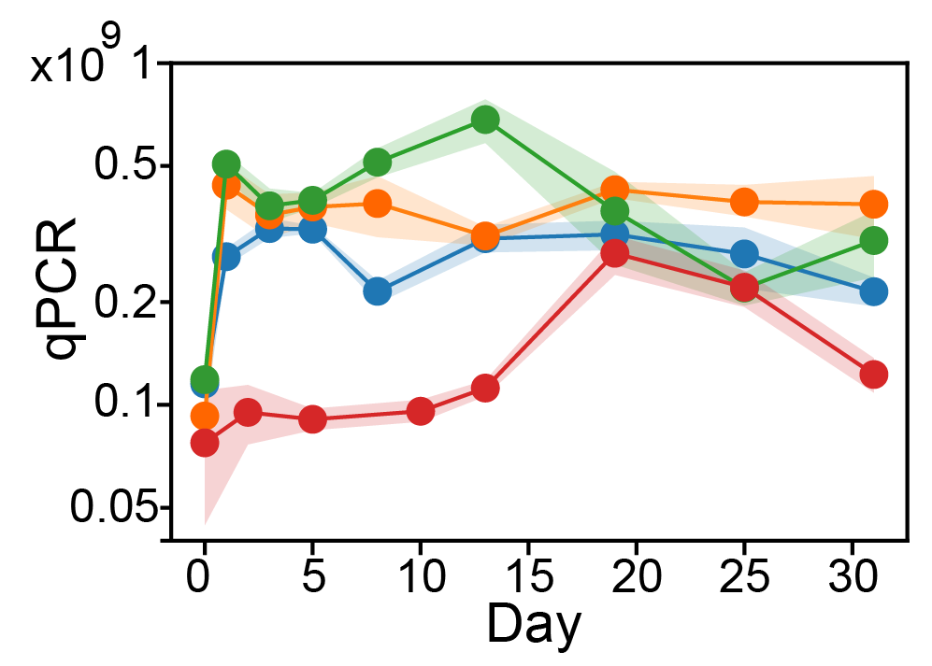
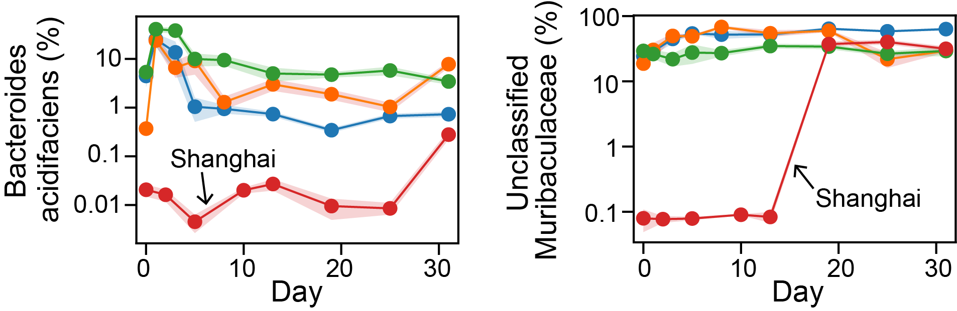
Take-home message:
Time- and baseline-dependence present major challenges for
understanding heterogenous prebiotic effects and
personalized nutritional therapy
Time dependence
Baseline dependence

